Slide 1
SLEUTH KIT LINUX
BY:
MUHAMMAD SHOAIB JAMAL
ARHAM IJAZ
ABDULLAH NAEEM

Slide 2
OUTLINE
About Sleuth Kit
Why Linux?
Features
Limitations
Importance
Benefits
Basic Command of sleuth kit

Slide 3

ABOUT SLEUTH KIT
01
In general sleuth kit is a forensic tool that works upon the command-line interface (CLI)
The Sleuth Kit (TSK) is a library and collection of command line digital forensics tools that allow you to investigate volume and file system data.
02
03
The library can be incorporated into larger digital forensics tools and the command line tools can be directly used to find evidence.

Slide 4

WHY LINUX?
A Linux workstation is a powerful tool for forensic investigation due to the wide support for many file systems,
The availability of advance tools and the ability to develop and compile source code.
Kali Linux supports more than 500 penetration testing and cybersecurity-related applications.

Slide 5
FEATURES OF SLEUTH KIT
Timeline Analysis
Data Carving
Multimedia
Web Artifacts
Recover deleted files from unallocated space using PhotoRec
Extract EXIF from pictures and watch videos.
Extract history, bookmarks, and cookies from Firefox, Chrome, and IE.
Advanced graphical event viewing interface

Slide 6

IMPORTANCE
It is widely used by forensic analysts, law enforcement agencies, and security professionals to examine and analyze data stored on a variety of media, including hard drives, USB drives, and memory cards.
STRENGTHS
You can simply impress your audience and add a unique zing
You can simply impress your audience and add a unique zing
W
SUPPORT FOR A WIDE RANGE OF FILE SYSTEMS:
The Sleuth Kit can be used to examine data on various file systems, including NTFS, FAT, exFAT, and Ext2/3/4.
O
T
THREATS
INTEGRATION WITH OTHER FORENSIC TOOLS:
The Sleuth Kit can be used in conjunction with other forensic tools, such as Autopsy and The Coroner's Toolkit (TCT). This allows forensic analysts to use a combination of tools to examine and analyze data in a forensic investigation.
OPPORTUNITIES
You can simply impress your audience and add a unique zing

Slide 7
BENEFITS OF SLEUTH KIT
OPEN SOURCE:
The Sleuth Kit is an open source tool, which means that it is freely available to anyone who wants to use it. This allows forensic analysts and other users to access the tool at no cost, making it an affordable option for forensic investigations.
ABILITY TO PERFORM FILE CARVING:
The Sleuth Kit includes tools that can be used to perform file carving, which is the process of recovering deleted or damaged files by examining the raw data on a storage device. This can be helpful in recovering evidence that may have been deleted or damaged.
CAPABILITY TO EXAMINE DATA AT VARIOUS LEVELS:
The Sleuth Kit can be used to examine data at various levels, including the file system level, the volume level, and the disk level. This allows forensic analysts to examine data at the lowest possible level, which can be helpful in uncovering evidence that may be hidden or deleted at higher levels.

Slide 8
LIMITATIONS
Limited support for some file systems:
The Sleuth Kit does not support all file systems, and some file systems may not be fully supported. For example, the Sleuth Kit does not support the Apple File System (APFS), which is used on newer Mac devices.
Requires knowledge of forensic techniques:
Using the Sleuth Kit effectively requires a good understanding of forensic techniques and how to apply them. Without this knowledge, users may not be able to fully utilize the tool's capabilities.
May be affected by system modifications:
If the system being examined has been modified in any way, it may affect the accuracy of the results produced by the Sleuth Kit. For example, if the system has been shut down improperly, it may affect the availability of certain data.

Slide 9
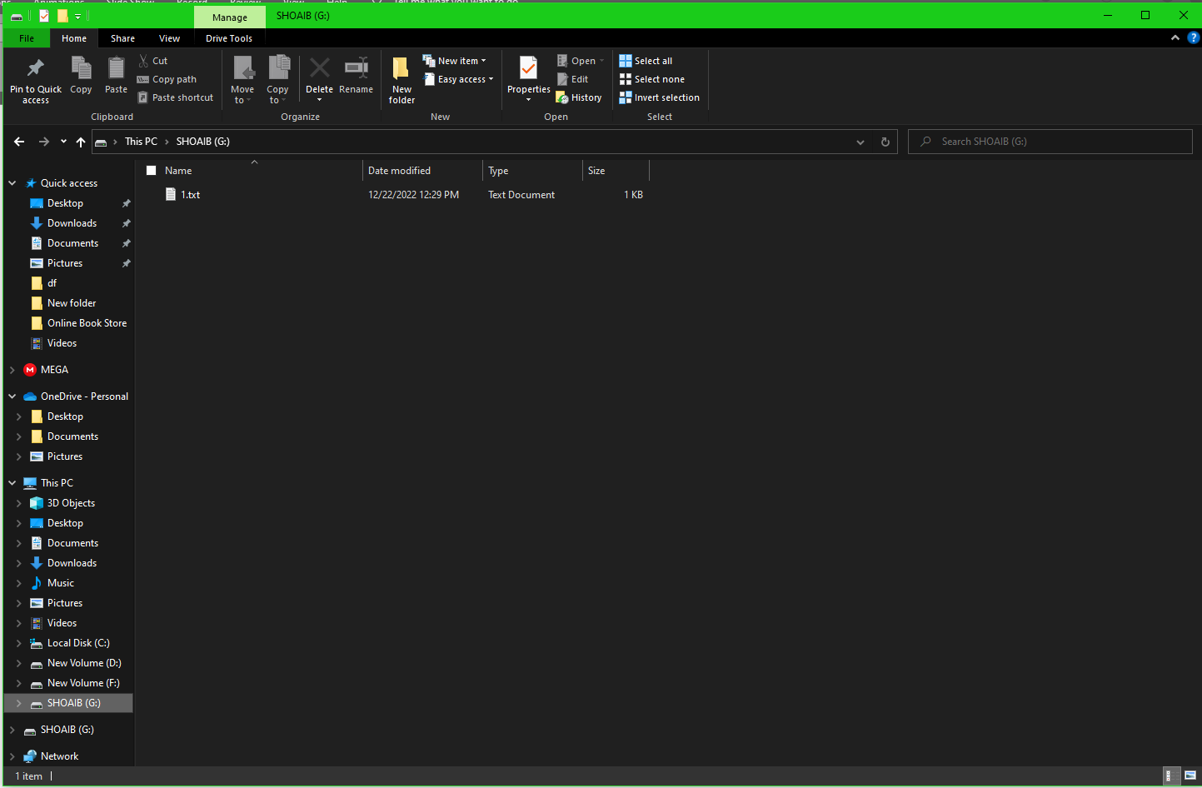
DEMO
USB;

Slide 10

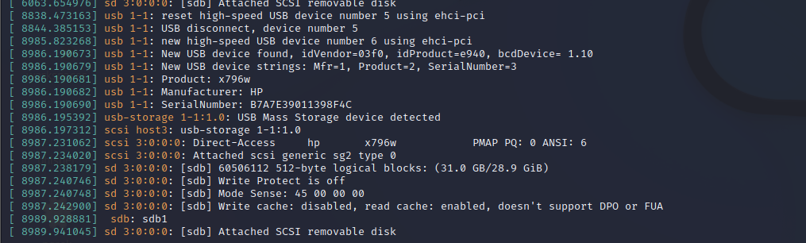
STEP 1;

Slide 11

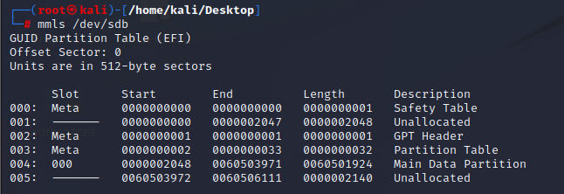
STEP 2;
STEP 3;

Slide 12
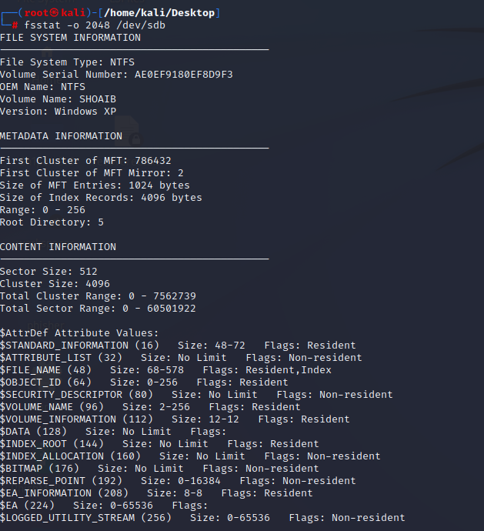
STEP 4;

Slide 13
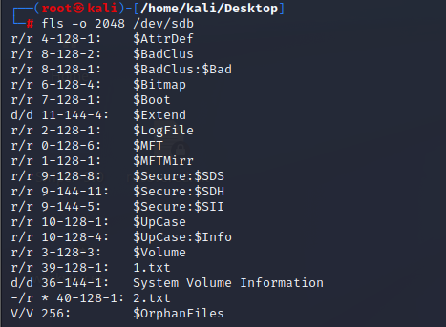
STEP 5;

Slide 14
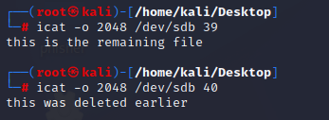
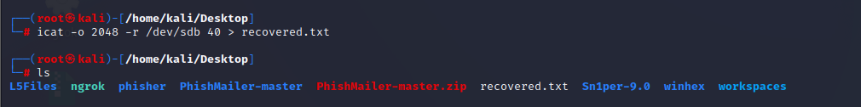
STEP 6;
STEP 7;

Slide 15
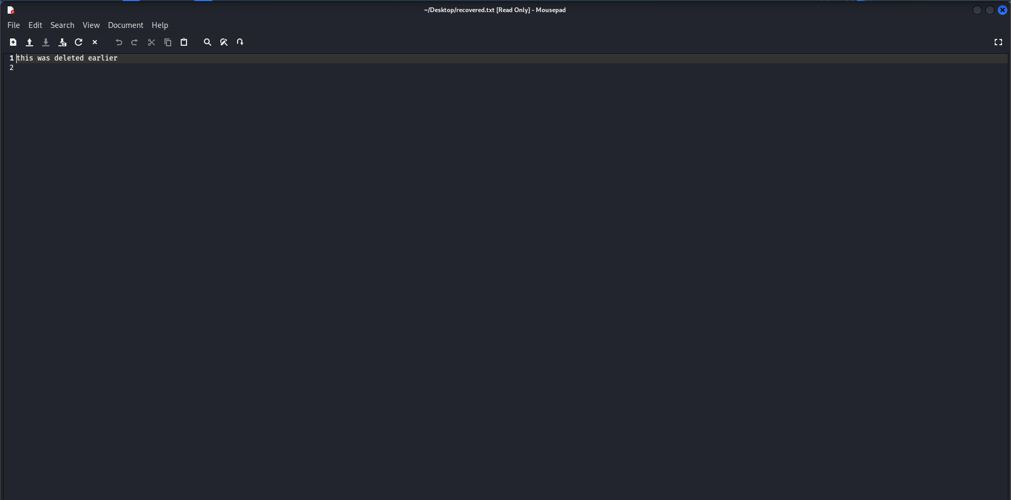
RECOVERED FILE;

Slide 16
THANK YOU

